Slide 1
Non-linear radiative response to patterned SST warming explained by non-linear tropical dynamics
Reported by: Heng Quan (hengquan@princeton.edu)
Princeton University, Atmospheric and Oceanic Sciences Program
Dec. 11th
Co-authors: Stephan Fueglistaler, Bosong Zhang, Chenggong Wang
Notes:
20
Climate sensitivity session: Non-additivity problem in the SST Green’s Functions approach
Large-scale dynamics session: Non-linear radiative response to patterned SST warming explained by non-linear tropical dynamics

Slide 2
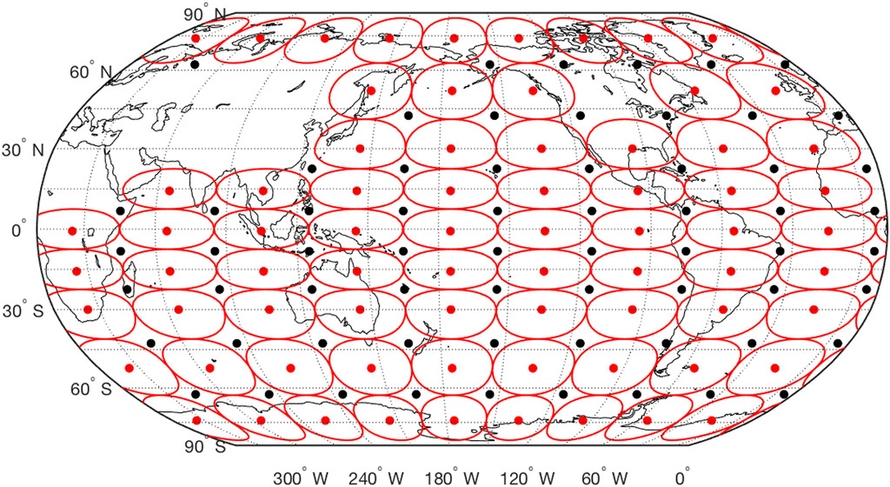
The SST Green’s functions approach:
$$∆\overline{R}=\sum_{j}{\frac{∂\overline{R}}{∂{SST}_{j}}∆{SST}_{j}}$$
$$∆\overline{R}=λ∆\overline{T}$$
AGCM ← SST warming in 4xCO₂ GCM
Y: $Δ\overline{R_{lw}}$
Truth
GF reconstruction
Dong et al., 2019
X: year
Zhang et al., 2023
$$∆\overline{R}\left(∆{SST}_{1},∆{SST}_{2},…\right)≠∆\overline{R}\left(∆{SST}_{1},0,0,…\right)+∆\overline{R}\left(0,∆{SST}_{2},0,…\right)+…$$
Motivation: Why is longwave radiation response overestimated by linear sum?
Notes:
1:05
1:25

Slide 3
Experiment design: two-patch combinations
AM4, SST+4K perturbation in two adjacent tropical Pacific patches
(37 combinations in total)
Y: actual response
$$∆\overline{R}\left(∆{SST}_{i},∆{SST}_{j}\right)$$
Color: average SST in two patches
X: linear sum
$$∆\overline{R}\left(∆{SST}_{i},0\right)+∆\overline{R}\left(0,∆{SST}_{j}\right)$$
Notes:
45
2:10
+ expected results
Measure the prediction error

Slide 4
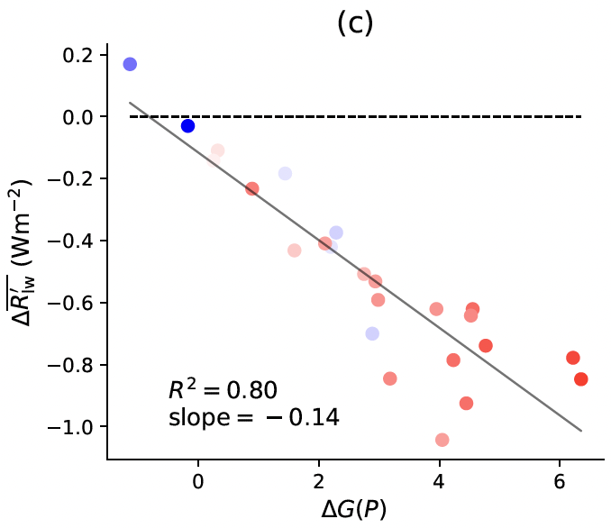
Radiation overestimation ← convection aggregation overestimation
$$∆G\left(P\right)$$
Tropical rainfall Gini index: $0<G\left(P\right)<100$
If $∆G\left(P\right)>0$:
Precipitation more spatially uneven
Convection more aggregated
Zhang and Fueglistaler 2020
(single patch SST+4K)
$$Δ\overline{R_{lw}′}∝ΔG(P)$$
Y: $Δ\overline{R_{lw}′}$
Stronger convection aggregation
→ mid-troposphere drying & high cloud reduction
→ Stronger longwave radiative cooling
Bony et al. 2020, Wing et al. 2020, Zhang et al. 2021
X:$ΔG(P)$

Slide 5
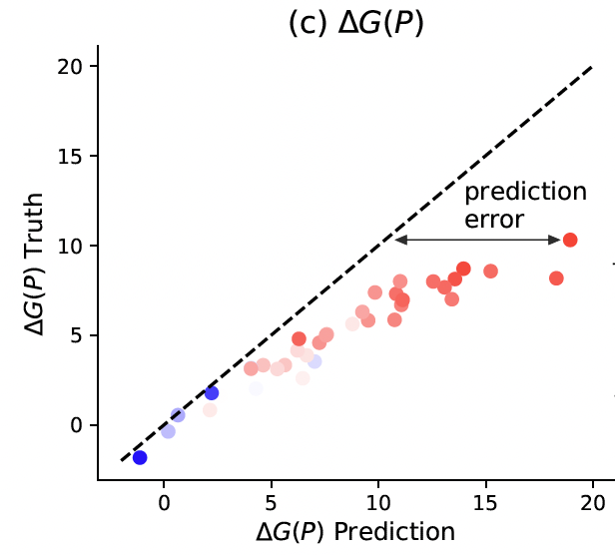
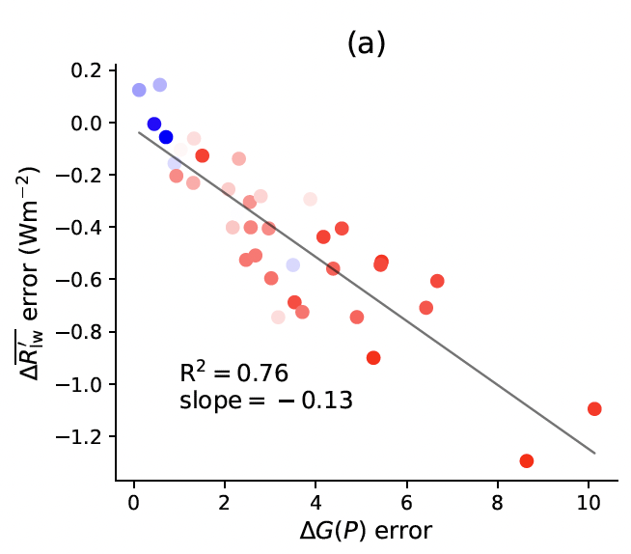
Radiation overestimation ← convection aggregation overestimation
Y: actual
response
$$Δ\overline{R_{lw}′}$$
Y: actual
response
$$ΔG(P)$$
X: linear sum
X: linear sum
Question: Why is convection aggregation response $ΔG\left(P\right)$ overestimated?
(two adjacent patches SST+4K)
$$Δ\overline{R_{lw}′} error∝ΔG\left(P\right) error$$
Notes:
45
3:55

Slide 6
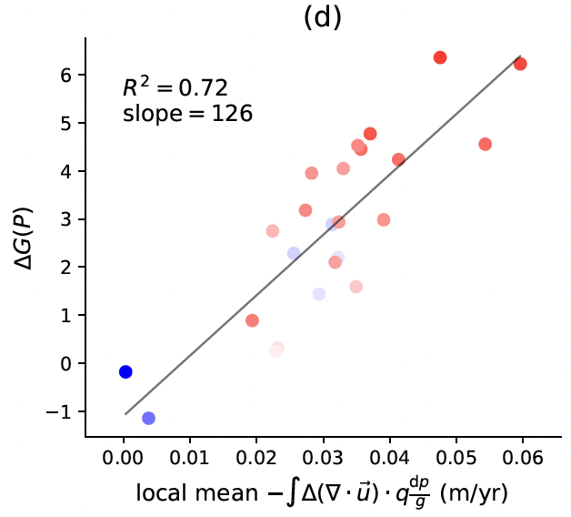
convection aggregation overestimation ← circulation overestimation
$$ΔP=ΔE−\int{∇⋅\left(Δ\vec{u}q\right)\frac{dp}{g}}+\int{∇⋅\left(\vec{u}⋅Δq\right)\frac{dp}{g}}$$
single patch SST+4K
dominant
Y:$ΔG(P)$
$ΔG\left(P\right)∝−\int{∇⋅\left(Δ\vec{u}q\right)\frac{dp}{g}}$ in perturbed region
X: $−\int{∇⋅\left(Δ\vec{u}q\right)\frac{dp}{g}}$ in perturbed region (m/yr)
Notes:
45
4:40

Slide 7
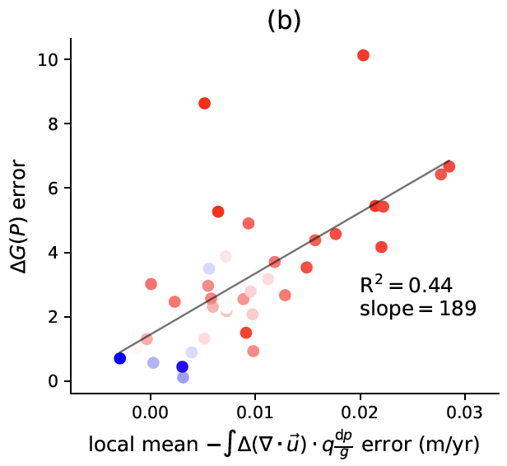
convection aggregation overestimation ← circulation overestimation
$−\int{∇⋅\left(Δ\vec{u}q\right)\frac{dp}{g}}$ in perturbed region
Y: actual
response
$$ΔG(P)$$
Y: actual
response
X: linear sum
X: linear sum
(two adjacent patches SST+4K)
Question: Why is circulation response overestimated?
$−\int{∇⋅\left(Δ\vec{u}q\right)\frac{dp}{g}}$ error in perturbed region
$ΔG\left(P\right) error∝−\int{∇⋅\left(Δ\vec{u}q\right)\frac{dp}{g}}$ error in perturbed region
Notes:
45
5:25

Slide 8
Circulation response non-additivity: spatial pattern
Circulation pattern similar to Gill 1980
Arrow: $Δ\vec{Q}≈∫Δ\vec{u} q dp/g$
Color: $Δ\left(−∇⋅\vec{Q}\right)$
Consistent with Lutsko 2018: tropical dynamics is non-linear upon large perturbation
Notes:
60
6:25

Slide 9
Conclusions
$$∆\overline{R}\left(∆{SST}_{1},∆{SST}_{2},…\right)≠∆\overline{R}\left(∆{SST}_{1},0,0,…\right)+∆\overline{R}\left(0,∆{SST}_{2},0,…\right)+…$$
Y: $Δ\overline{R_{lw}′}$
error
Y: $ΔG\left(P\right)$
error
X: $ΔG(P)$ error
X: $−\int{∇⋅\left(Δ\vec{u}q\right)\frac{dp}{g}}$ error
Radiation non-additivity
Convection aggregation non-additivity
Circulation non-additivity
using the GF approach to predict future climate change would overestimate longwave radiative cooling and underestimate climate sensitivity.

Slide 10
Thanks!
Preprint & Contact me:
hengquan@princeton.edu
https://heng-quan.github.io
Notes:
40
7:40

Slide 11
Back-up slides

Slide 12
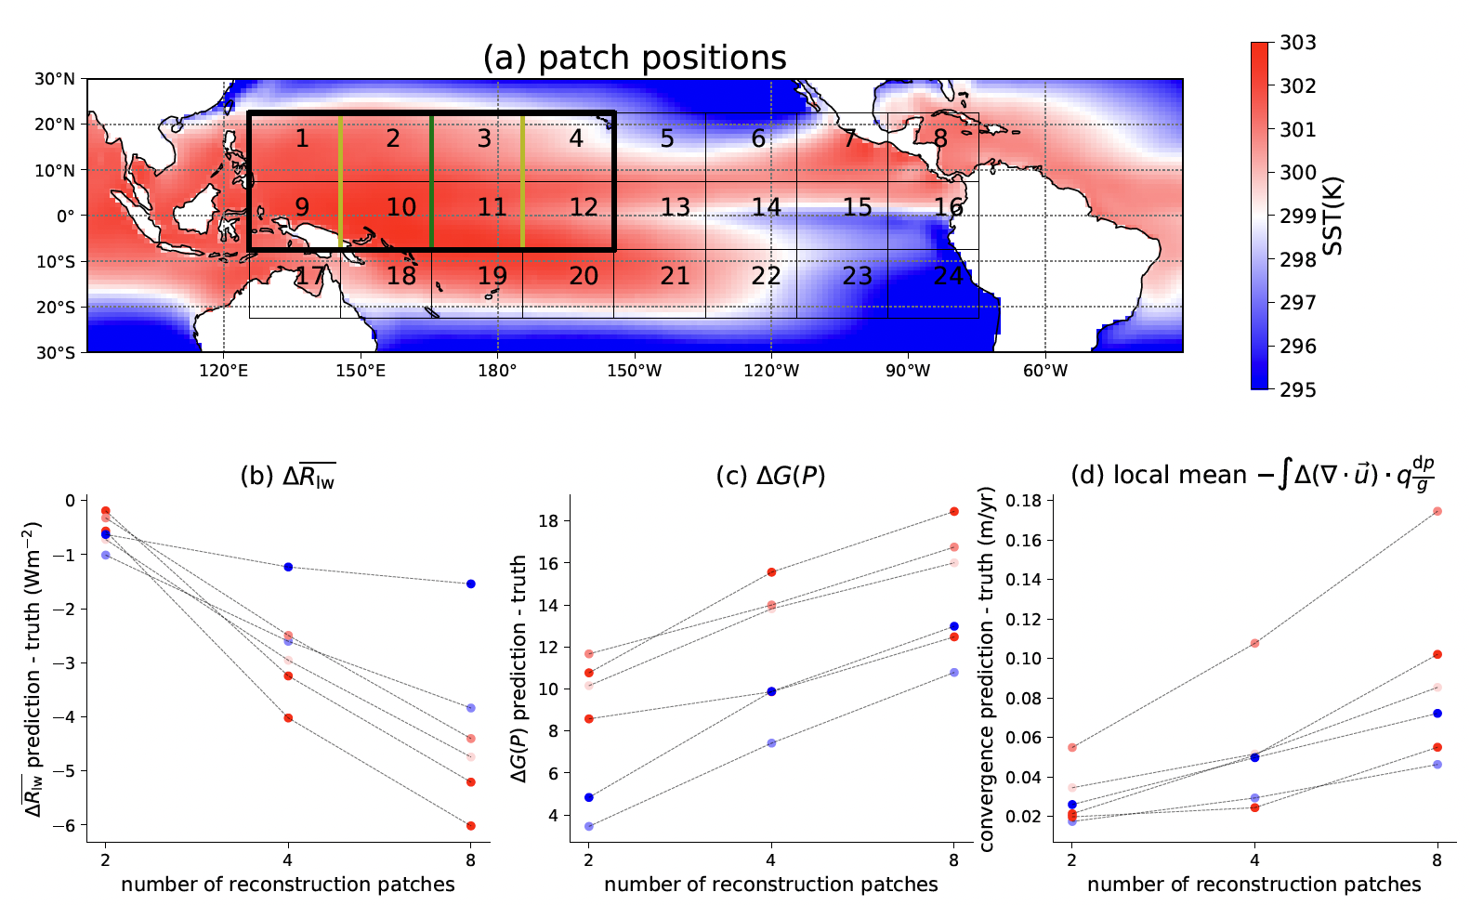
Two-patch combination to multi-patch combination:
More (/smaller) patches → larger errors
$−\int{∇⋅\left(Δ\vec{u}⋅q\right)\frac{dp}{g}}$ in perturbed region (m/yr)
Y: Prediction
error
X: Number of reconstruction patches
Notes:
30
7:00

Slide 13
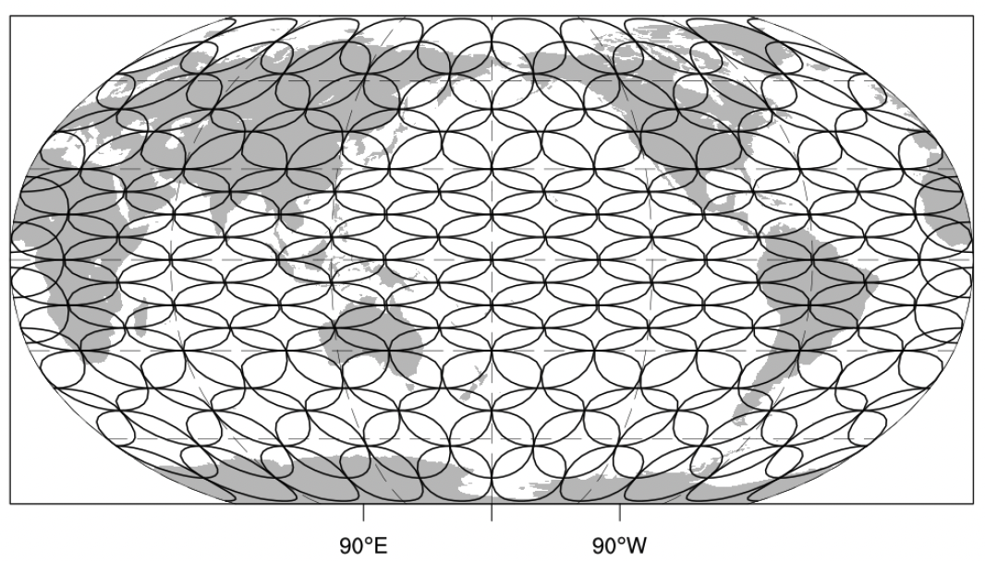
The failure of the Green’s Functions approach
AM4 4xCO₂: fails
Zhang et al., 2023
Truth
GF reconstruction
X: year
The Green’s Functions approach fails in AM4 4xCO₂ radiation reconstruction due to the overestimation of convection aggregation

Slide 14
Linear sum overestimates TOA radiation responses
AM4, SST+4K perturbation in two adjacent tropical Pacific patches
(37 combinations in total)

Slide 15
Gini index measures large-scale convection aggregation strength
$$ΔG\left(P\right)>0$$
single patch SST+4K $ΔG\left(P\right)$ responses
Muller and Held, 2012

Slide 16
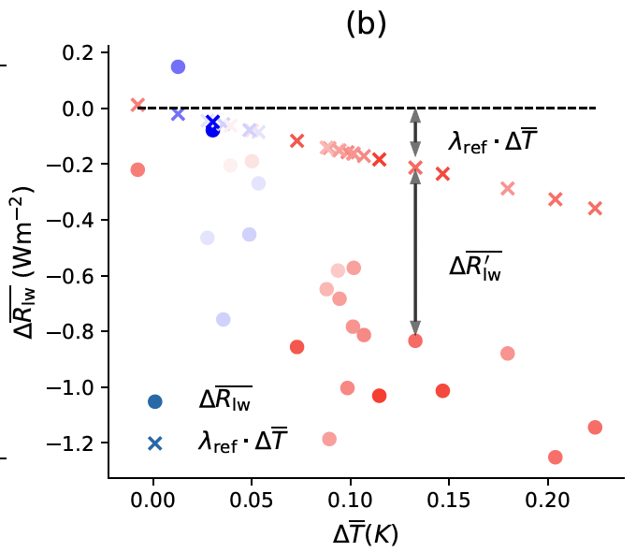
Longwave radiation response attributed to convection aggregation
$λ_{ref}⋅Δ\overline{T}$ due to mean surface warming
$Δ\overline{R_{lw}′}$ due to convection aggregation (dominant)
(single patch SST+4K)
$$Δ\overline{R_{lw}′}∝ΔG(P)$$
Stronger convection aggregation
→ mid-troposphere drying & high cloud reduction
→ Stronger longwave radiative cooling
Bony et al. 2020, Wing et al. 2020, Zhang et al. 2021

Slide 17
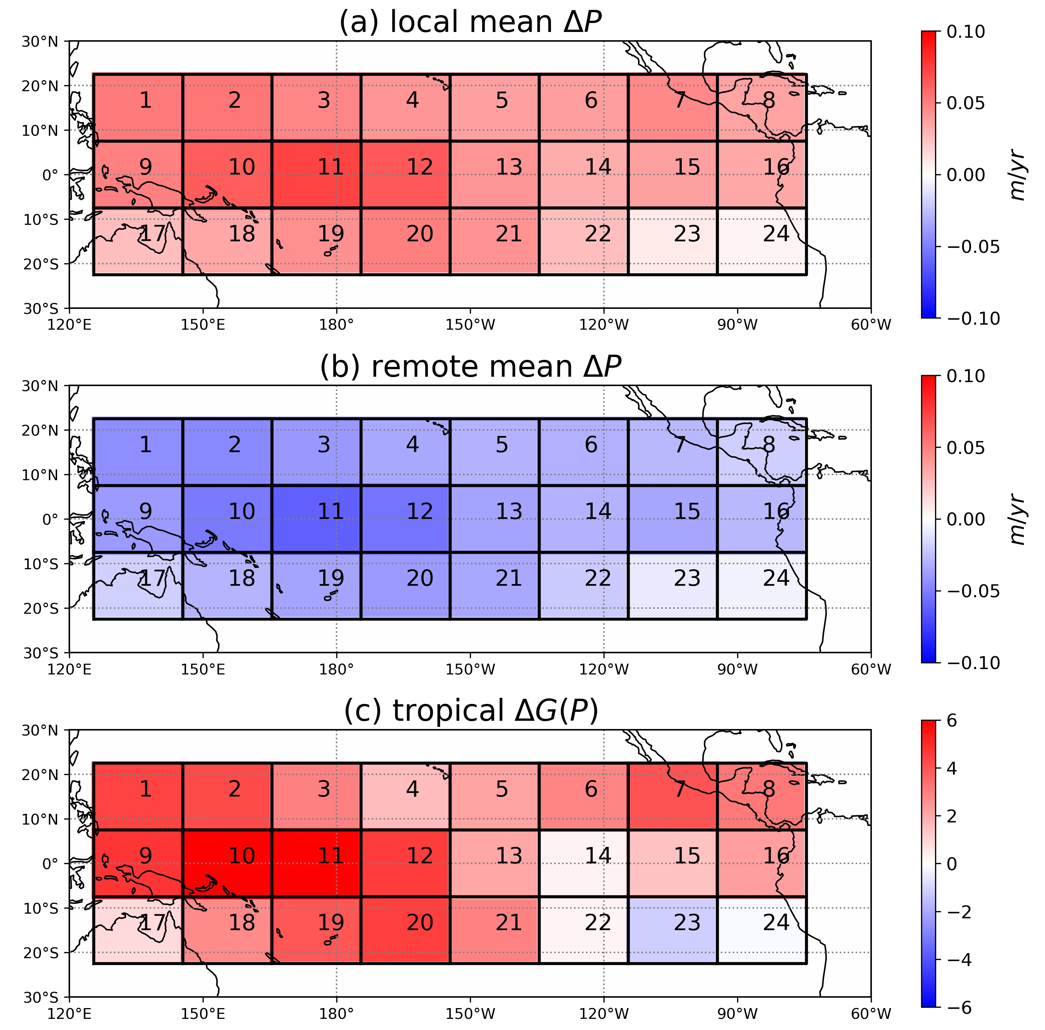
convection aggregation response caused by circulation change
single patch SST+4K
dominant
$$ΔG\left(P\right)∝−\int{Δ\left(∇⋅\vec{u}\right)⋅q\frac{dp}{g}}$$

Slide 18
Radiation overestimation attributed to convection aggregation overestimation
(two adjacent patches SST+4K)
$$Δ\overline{R_{lw}′} error∝ΔG\left(P\right) error$$

Slide 19
Local $ΔSST>0$
local
remote
$$Δ\left(∇⋅\vec{u}\right)<0$$
$$Δ\left(∇⋅\vec{u}\right)>0$$
$$Δ\left(∇⋅\vec{Q}\right)<0$$
$$Δ\left(∇⋅\vec{Q}\right)>0$$
$$Δ\vec{Q}≈∫Δ\vec{u} q dp/g$$
$$Δ\overline{TS}>0$$
$$ΔP>0$$
$$ΔP<0$$
$$ΔP≈Δ(−∇⋅\vec{Q})$$
$$λ_{LW}×Δ\overline{TS}<0$$
(for convective / warm patch)
Convection aggregation $ΔG(P)>0$
High cloud reduction $Δ\overline{HCC}<0$
(relative to uniform warming)
$$Δ\overline{R_{lw}}<0$$
Global mean drying $Δ\overline{MTH}<0$
additive
$$Δ\overline{R_{lw}′}<0$$
overestimated

