Slide 1

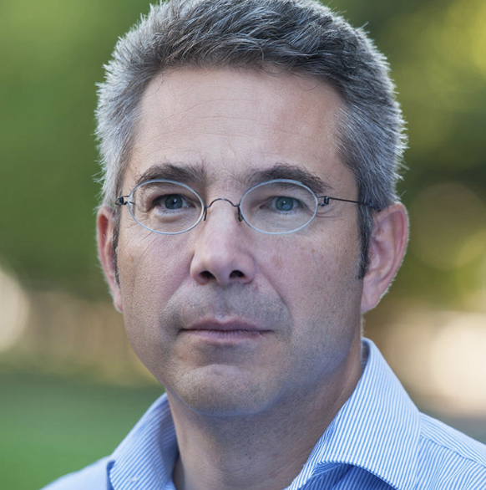
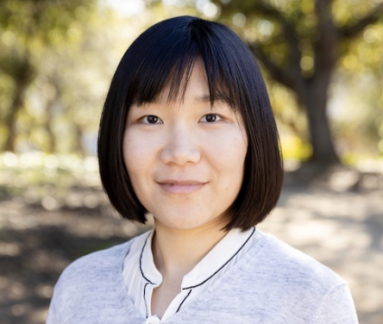
Weakening of tropical free tropospheric temperature gradients with global warming
Reported by: Heng Quan
PhD candidate, Princeton University
Collaborators:
Stephan Fueglistaler, Princeton University
Yi Zhang, New York University
Dec.13th
Notes:
Climate sensitivity session: Non-additivity problem in the SST Green’s Functions approach
Large-scale dynamics session: Non-linear radiative response to patterned SST warming explained by non-linear tropical dynamics

Slide 2
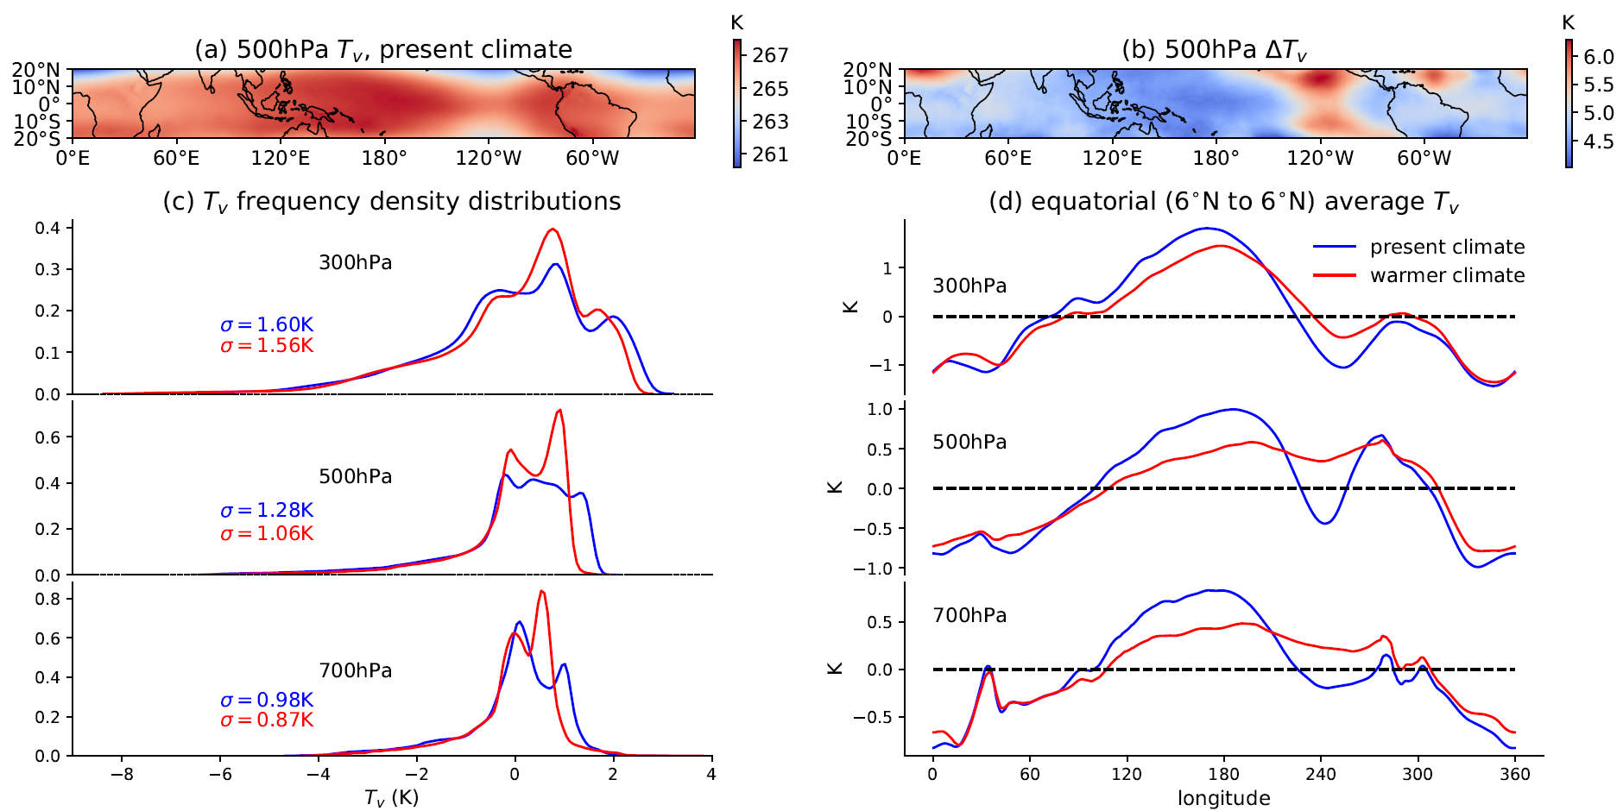
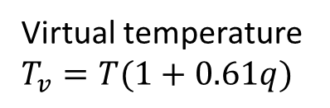
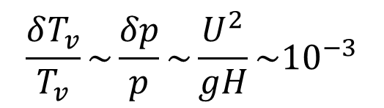
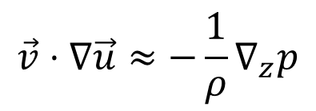
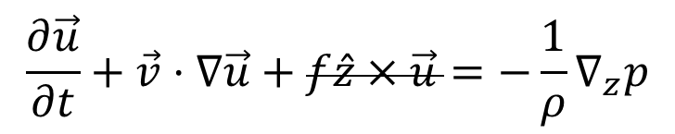
The weak temperature gradient approximation (Charney 1963, JAS)
$$\frac{∂\vec{u}}{∂t}+\vec{v}⋅∇\vec{u}+f\hat{z}×\vec{u}=−\frac{1}{ρ}∇_{z}p$$
Virtual temperature $T_{v}=T(1+0.61q)$
$$\vec{v}⋅∇\vec{u}≈−\frac{1}{ρ}∇_{z}p$$
Question: How will tropical free tropospheric temperature gradient respond to global warming?
$$\frac{δT_{v}}{T_{v}}\sim \frac{δp}{p}\sim \frac{U^{2}}{gH}\sim {10}^{−3}$$

Slide 3
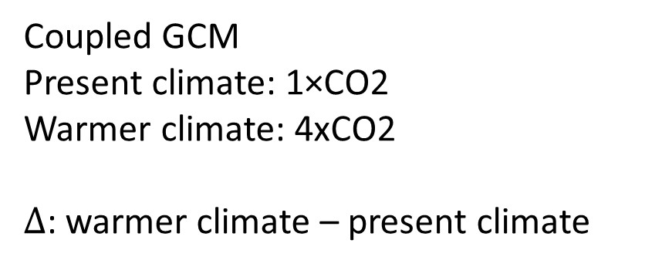
GCM shows weaker temperature gradient in a warmer climate
Coupled GCM
Present climate: 1×CO2
Warmer climate: 4xCO2
$Δ$: warmer climate – present climate

Slide 4
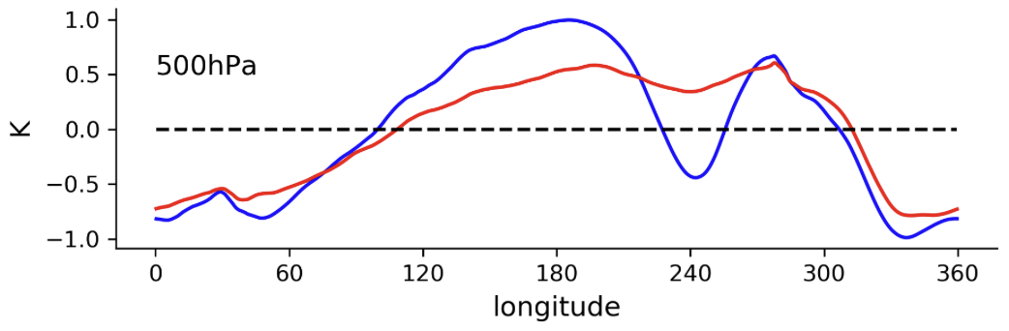

GCM shows weaker temperature gradient in a warmer climate
(normalized)
Question: What causes weaker (zonal) temperature gradient (close to equator)?

Slide 5
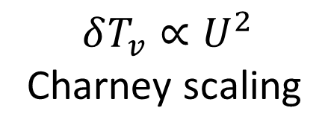
Hypothesis: weaker circulation → weaker T gradient
$−\frac{1}{ρ}\frac{∂p}{∂x}≈\left(−\vec{v}⋅∇u\right)$ close to equator (Bao et al., 2022, JCLI)
Weaker (Walker) circulation (Held & Soden, 2006, JCLI)
Weaker momentum advection
Weaker pressure gradient
Weaker temperature gradient
$$δT_{v}∝U^{2}$$
Charney scaling

Slide 6
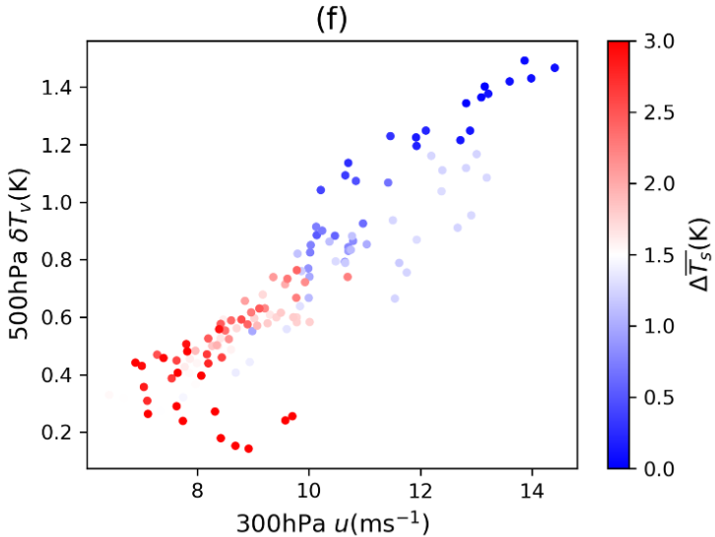
GCM evidence: Weaker circulation → weaker T gradient
Coupled GCM, CO2 +1%/yr
global warming

Slide 7
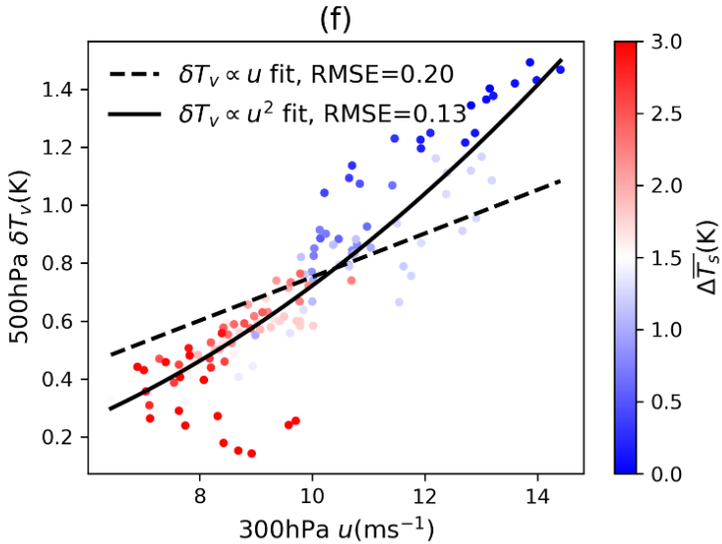
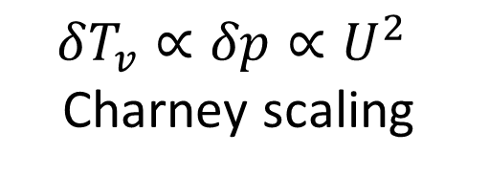
GCM evidence: Weaker circulation → weaker T gradient
Coupled GCM, CO2 +1%/yr
$$δT_{v}∝δp∝U^{2}$$
Charney scaling

Slide 8
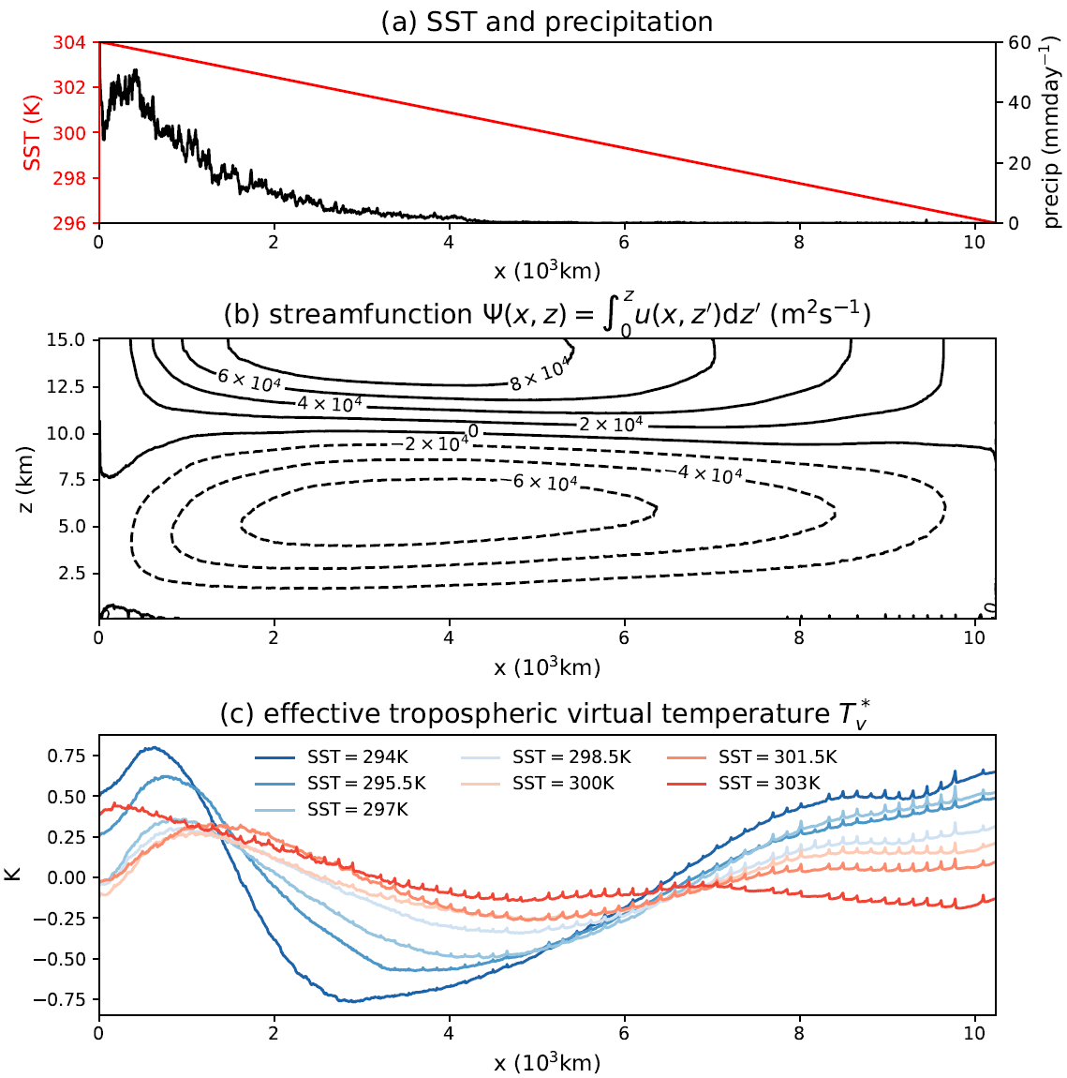
CRM verification: weaker circulation → weaker T gradient
Cloud Resolving model (CRM) - SAM
2-D (x-z) mock Walker circulation
Prescribed linear SST
Prescribed uniform radiative cooling rate

Slide 9
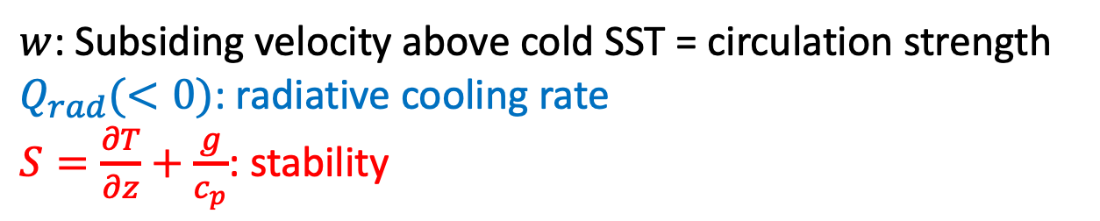
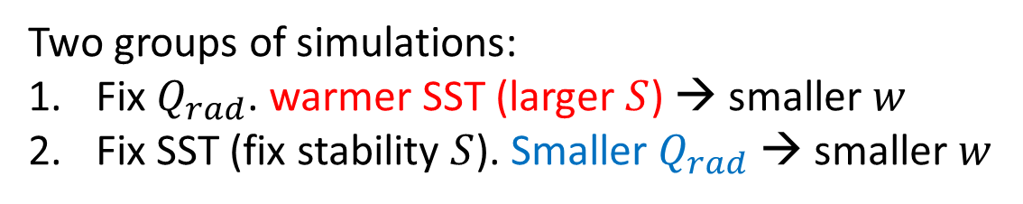

CRM verification: weaker circulation → weaker T gradient
$$w=\frac{Q_{rad}}{S}$$
$w$: Subsiding velocity above cold SST = circulation strength
$Q_{rad}(<0)$: radiative cooling rate
$S=\frac{∂T}{∂z}+\frac{g}{c_{p}}$: stability
Two groups of simulations:
Fix $Q_{rad}$. warmer SST (larger $S$) → smaller $w$
Fix SST (fix stability $S$). Smaller $Q_{rad}$ → smaller $w$

Slide 10
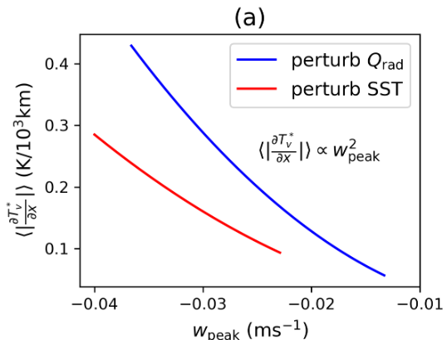
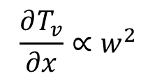
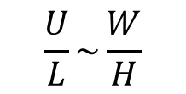
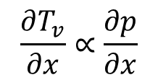
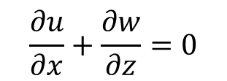
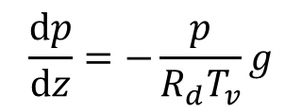
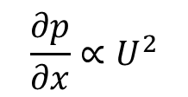
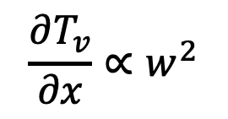
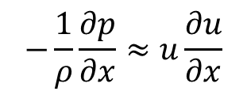
CRM verification: weaker circulation → weaker T gradient
$$\frac{∂u}{∂x}+\frac{∂w}{∂z}=0$$
$$\frac{U}{L}\sim \frac{W}{H}$$
(quantitative predictions)
$$−\frac{1}{ρ}\frac{∂p}{∂x}≈u\frac{∂u}{∂x}$$
$$\frac{∂p}{∂x}∝U^{2}$$
$$\frac{∂T_{v}}{∂x}∝w^{2}$$
See our paper for estimation of the coefficient
$$\frac{dp}{dz}=−\frac{p}{R_{d}T_{v}}g$$
$$\frac{∂T_{v}}{∂x}∝\frac{∂p}{∂x}$$
$$\frac{∂T_{v}}{∂x}∝w^{2}$$

Slide 11
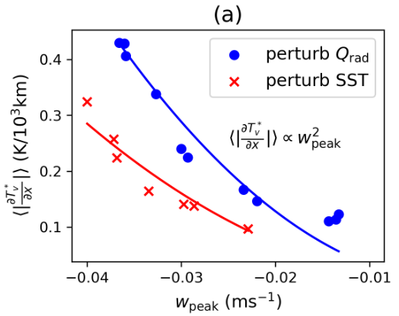
CRM verification: weaker circulation → weaker T gradient
$$\frac{∂u}{∂x}+\frac{∂w}{∂z}=0$$
$$\frac{U}{L}\sim \frac{W}{H}$$
$$−\frac{1}{ρ}\frac{∂p}{∂x}≈u\frac{∂u}{∂x}$$
$$\frac{∂p}{∂x}∝U^{2}$$
$$\frac{∂T_{v}}{∂x}∝w^{2}$$
See our preprint for estimation of the coefficient
$$\frac{dp}{dz}=−\frac{p}{R_{d}T_{v}}g$$
$$\frac{∂T_{v}}{∂x}∝\frac{∂p}{∂x}$$
Consistent with model results!
$$\frac{∂T_{v}}{∂x}∝w^{2}$$

Slide 12

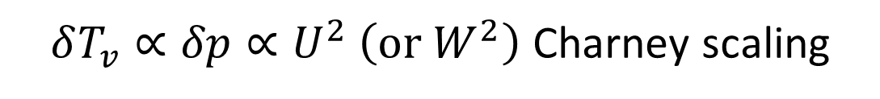
Conclusion: weaker circulation causes weaker tropical free troposphere temperature gradient in a warmer climate
GCM
CRM mock-Walker
(Quan et al., 2024, JAS)
$δT_{v}∝δp∝U^{2} \left(\text{or} W^{2}\right)$ Charney scaling

Slide 13
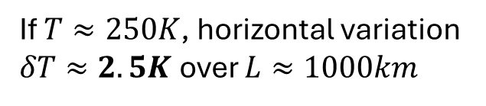
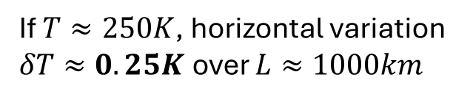
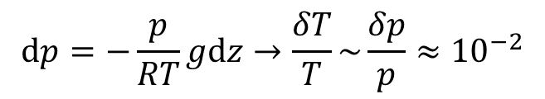
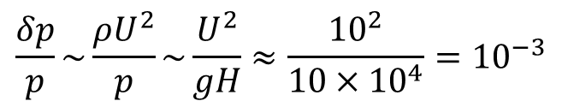
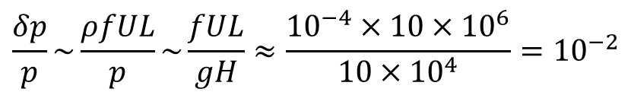
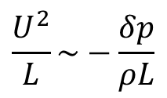
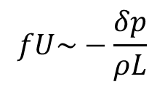
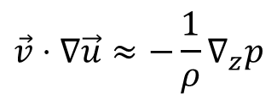
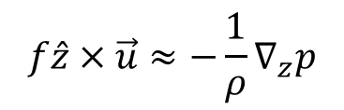
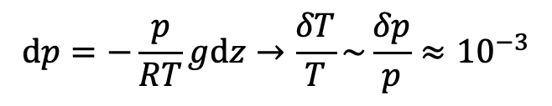
The weak temperature gradient approximation (Charney 1963, JAS)
$\frac{∂\vec{u}}{∂t}+\vec{v}⋅∇\vec{u}+f\hat{z}×\vec{u}=−\frac{1}{ρ}∇_{z}p$, large-scale $L≈1000km$
midlatitude free-troposphere
Tropical free-troposphere
$$f\hat{z}×\vec{u}≈−\frac{1}{ρ}∇_{z}p$$
$$\vec{v}⋅∇\vec{u}≈−\frac{1}{ρ}∇_{z}p$$
$$fU\sim −\frac{δp}{ρL}$$
$$\frac{U^{2}}{L}\sim −\frac{δp}{ρL}$$
$$\frac{δp}{p}\sim \frac{ρfUL}{p}\sim \frac{fUL}{gH}≈\frac{{10}^{−4}×10×{10}^{6}}{10×{10}^{4}}={10}^{−2}$$
$$\frac{δp}{p}\sim \frac{ρU^{2}}{p}\sim \frac{U^{2}}{gH}≈\frac{{10}^{2}}{10×{10}^{4}}={10}^{−3}$$
$$dp=−\frac{p}{RT}gdz→\frac{δT}{T}\sim \frac{δp}{p}≈{10}^{−2}$$
$$dp=−\frac{p}{RT}gdz→\frac{δT}{T}\sim \frac{δp}{p}≈{10}^{−3}$$
If $T≈250K$, horizontal variation $δT≈2.5K$ over $L≈1000km$
If $T≈250K$, horizontal variation $δT≈0.25K$ over $L≈1000km$

Slide 14
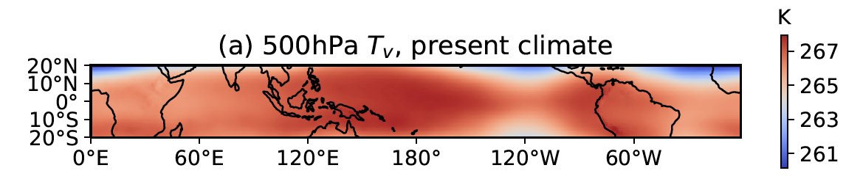
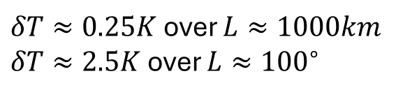
The weak temperature gradient approximation (Charney 1963, JAS)
Tropical free troposphere cannot maintain large horizontal temperature gradient due to the smallness of the Coriolis parameter close to equator (Charney 1963, JAS).
Weak temperature gradient is NOT zero temperature gradient; Convective regions can be ~3K warmer than subsiding regions (Bao et al., 2022, JCLI).
$δT≈0.25K$ over $L≈1000km$
$δT≈2.5K$ over $L≈{100}^{∘}$
Virtual temperature $T_{v}=T(1+0.61q)$ where $q$ is specific humidity
Question: How will tropical free troposphere temperature gradient respond to global warming?

Slide 15
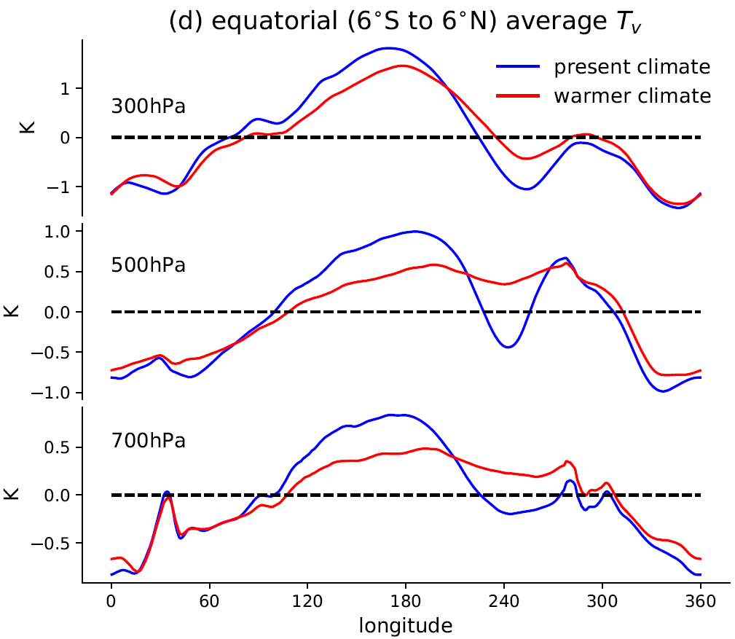
GCM shows weaker temperature gradient in a warmer climate

Slide 16
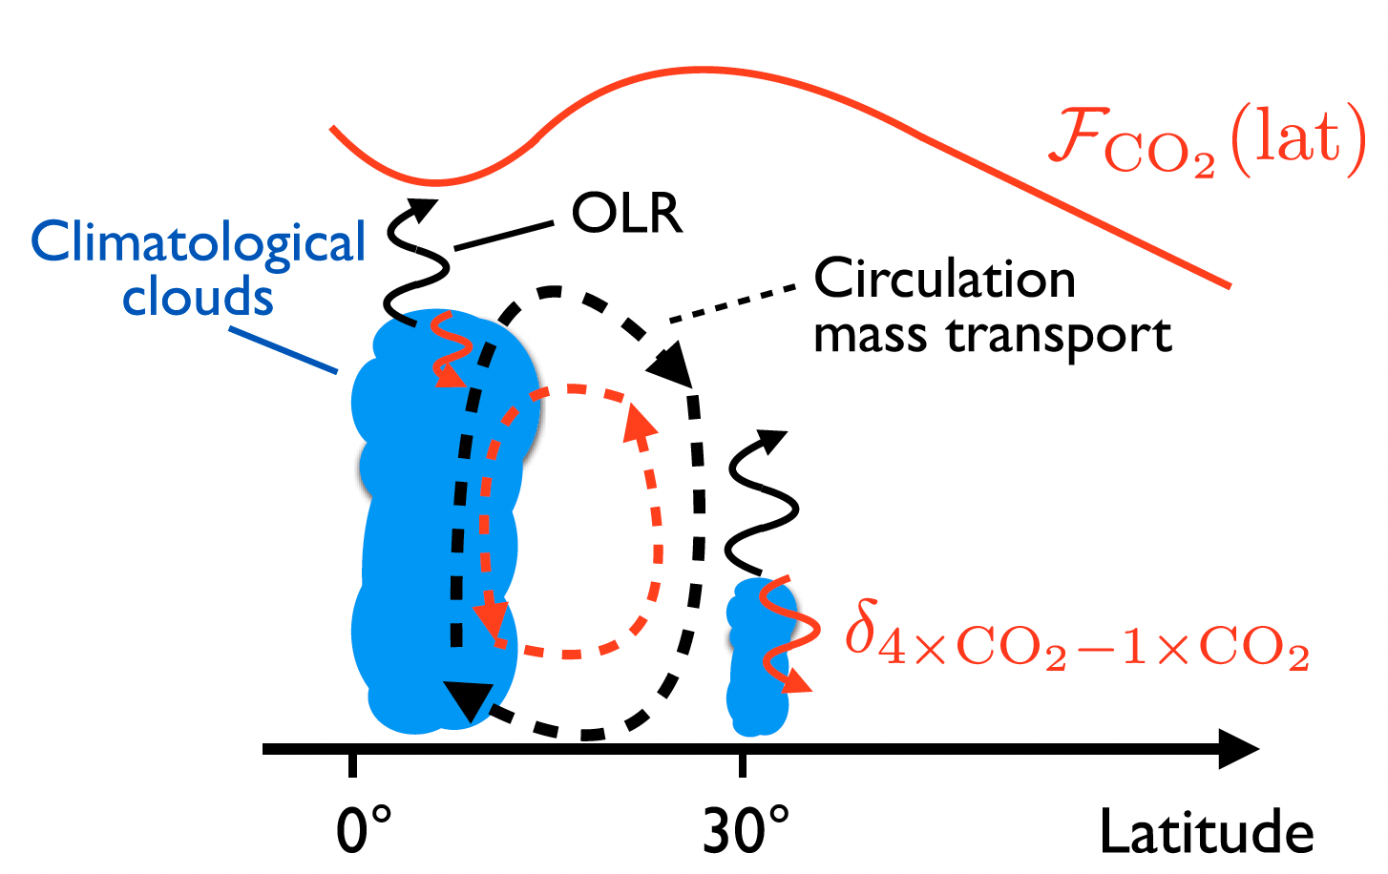
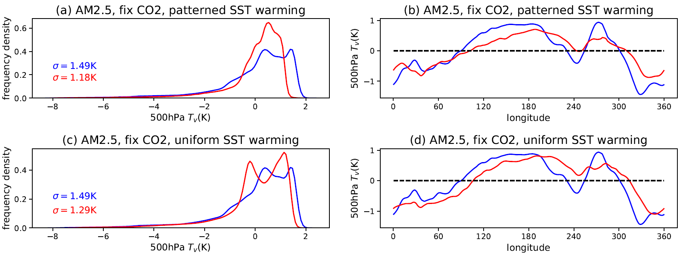
Hypothesis: masked CO2 forcing → weaker T gradient
❌
Merlis 2015, PNAS
Larger CO2 forcing in subsiding regions causes greater free troposphere warming?
Without CO2 forcing, temperature gradient still becomes weaker

Slide 17
Hypothesis: patterned SST warming → weaker T gradient
❌
Larger surface warming in subsiding regions → larger free-troposphere warming?
Without patterned SST warming, temperature gradient still becomes weaker

Slide 18
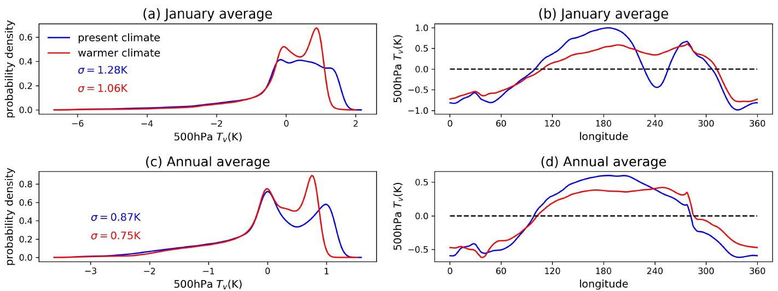
GCM shows weaker temperature gradient in a warmer climate
Annual mean results similar to January mean results

Slide 19
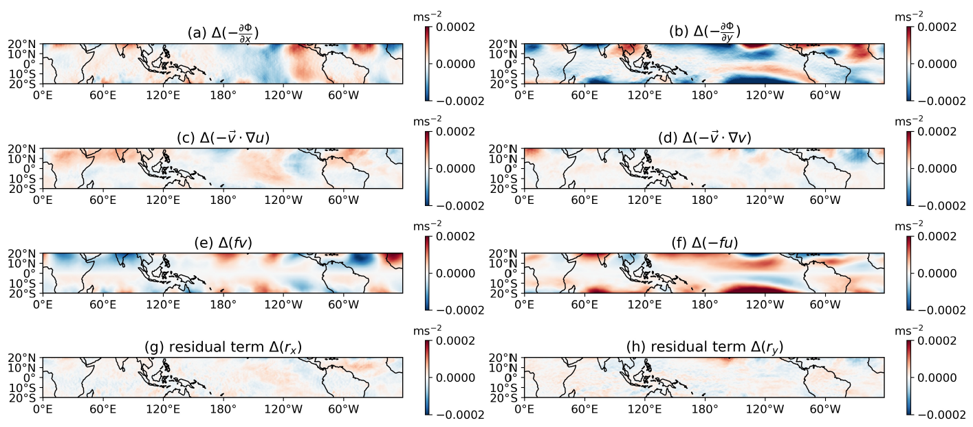
Hypothesis: circulation weakening → weaker T gradient ✅
Weaker meridional pressure gradients balanced by weaker Coriolis force (i.e. weaker westerly)

Slide 20
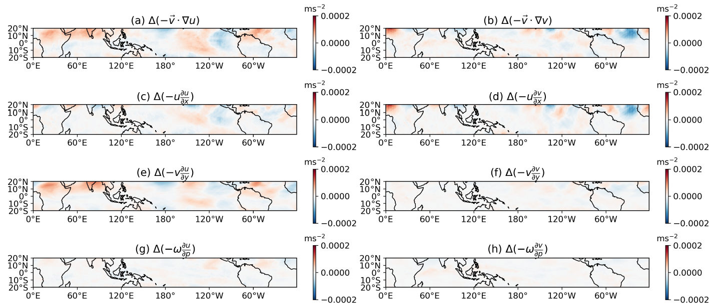
Hypothesis: circulation weakening → weaker T gradient ✅
Decomposition of momentum advection terms

Slide 21
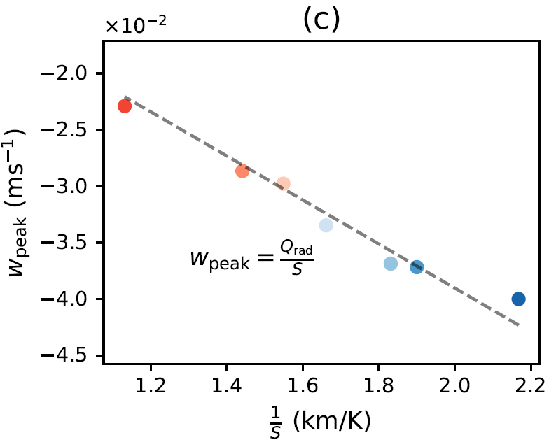
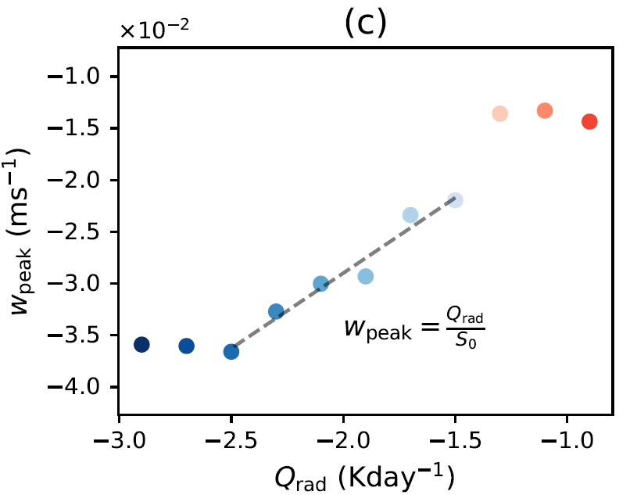






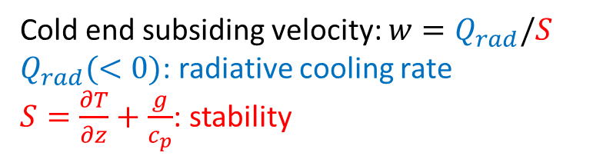


CRM verification: weaker circulation → weaker T gradient
Cold end subsiding velocity: $w=Q_{rad}/S$
$Q_{rad}(<0)$: radiative cooling rate
$S=\frac{∂T}{∂z}+\frac{g}{c_{p}}$: stability
1. Fix $Q_{rad}$
2. Fix SST (fix stability $S$)
$$w∝\frac{1}{S}$$
$$w∝Q_{rad}$$
smaller $w$
smaller $w$
warmer SST (larger stability $S$)
Smaller $Q_{rad}$

Slide 22
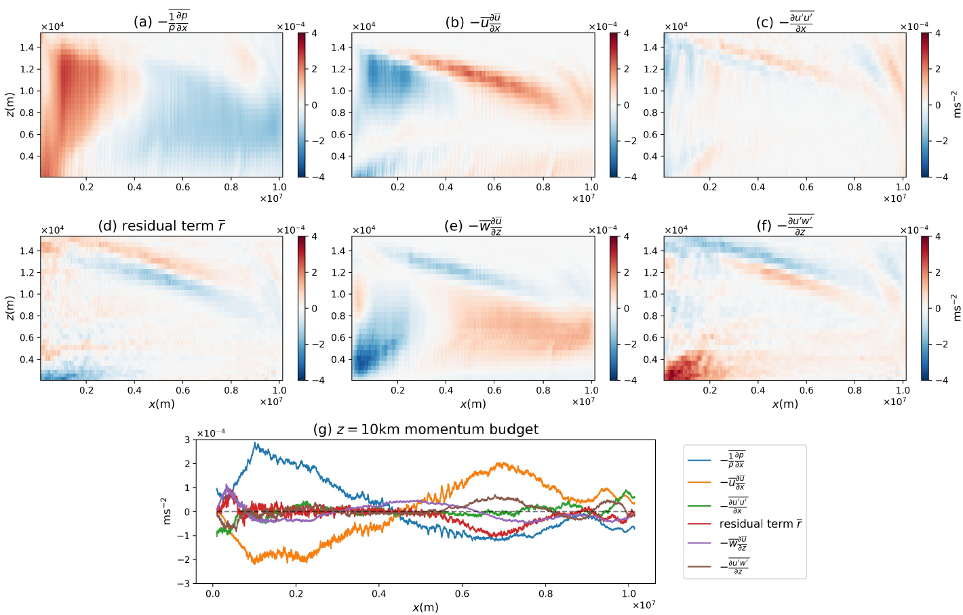

CRM verification: weaker circulation → weaker T gradient
Momentum equation: $−\frac{1}{ρ}\frac{∂p}{∂x}+\left(−\overline{u}\frac{∂\overline{u} }{∂x}\right)≈0$

Slide 23

CRM verification: weaker circulation → weaker T gradient
2-D horizontal velocity structures show regime shift when $Q_{rad}$ becomes very small

