Slide 1
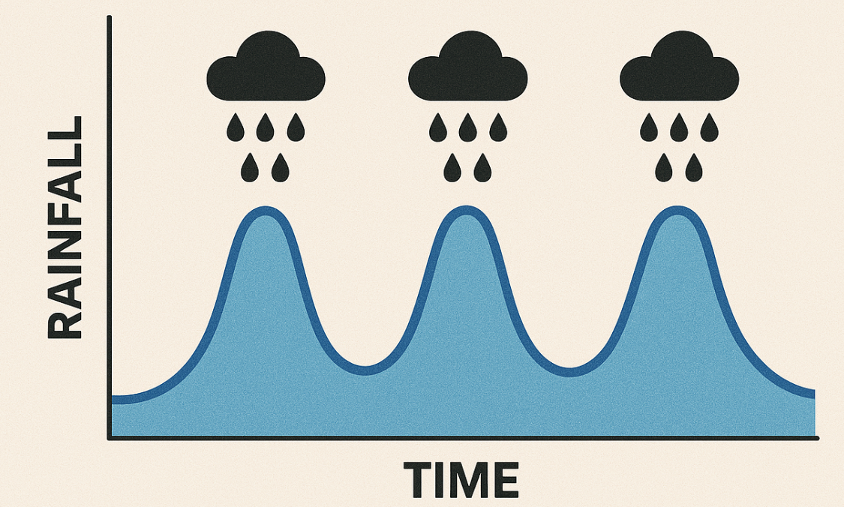
Periodic extreme rainfall in a warmer climate due to stronger convectively-coupled waves
Reported by: Heng Quan (hengquan@princeton.edu)
Collaborators: Yi Zhang, Stephan Fueglistaler, Guy Dagan
Dec 15th
Image generated by ChatGPT
Notes:
30

Slide 2
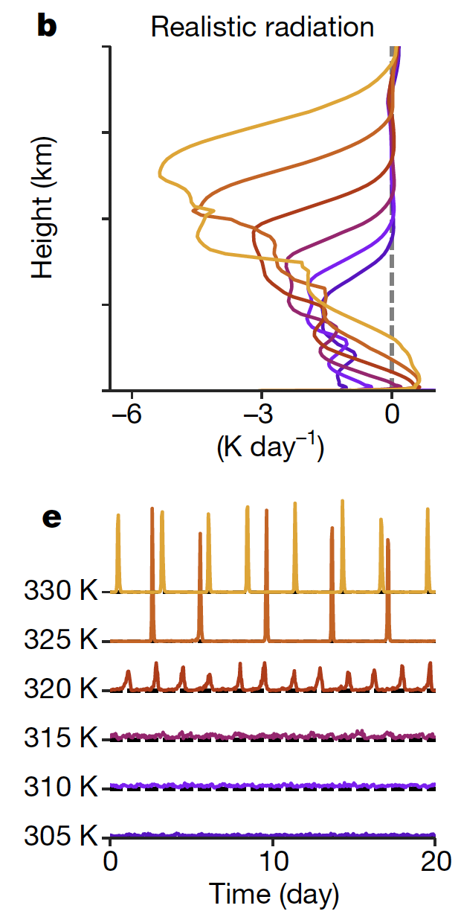
Motivation: periodic extreme rainfall in hothouse climates
precipitation
Radiative cooling rate
128 km
128 km
Small-domain simulations with different SSTs
Transition to periodic extreme rainfall at 320-325 K in small-domain simulations (Seeley & Wordsworth, 2021, Nature + many following studies)
Research question: similar transition in global-scale simulations?

Slide 3
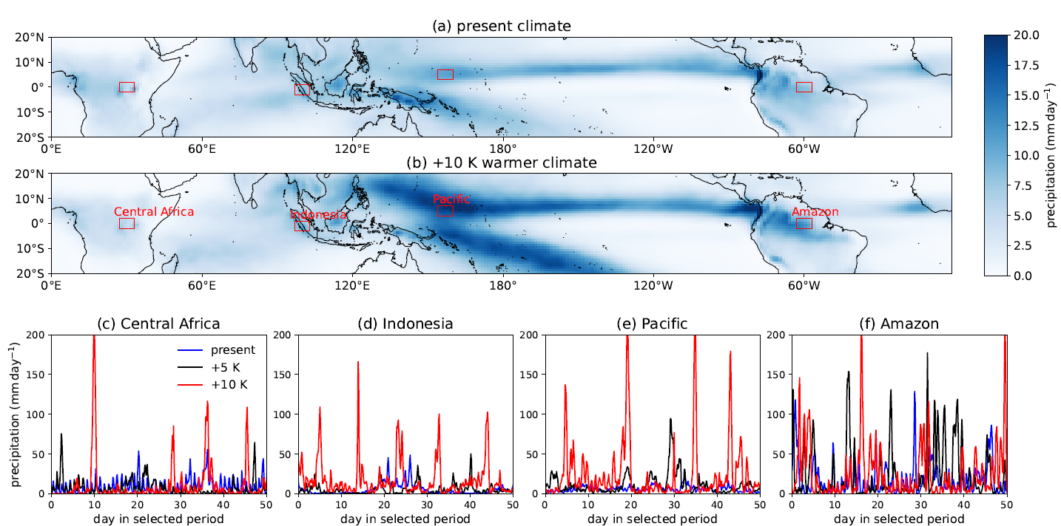
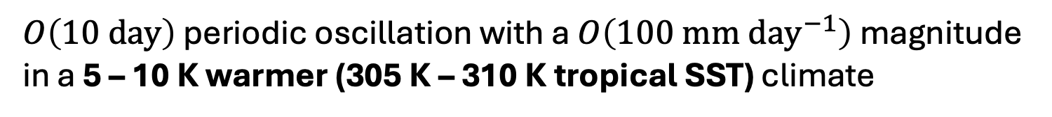
Periodic extreme rainfall in a warmer climate – GCM simulations
GFDL-AM4
Fixed SST
15-year
3-hourly
Present SST
Uniform +5 K
Uniform +10 K
$O\left(10 day\right)$ periodic oscillation with a $O\left(100 mm {day}^{−1}\right)$ magnitude in a 5 – 10 K warmer (305 K – 310 K tropical SST) climate
Notes:
80

Slide 4
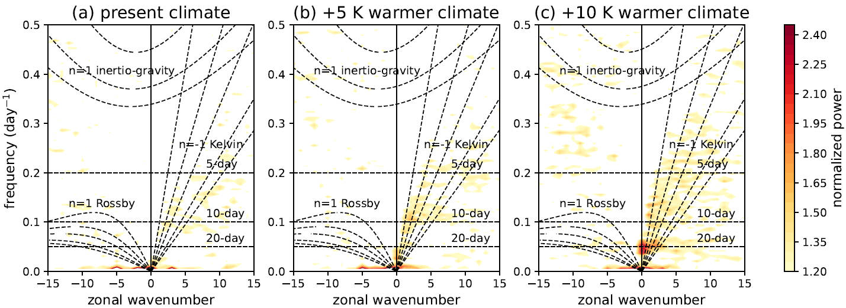
Transition associated with stronger convectively-coupled waves
Wave spectrums of equatorial (10 S – 10 N) precipitation
stronger convectively-coupled Kelvin waves
Notes:
40

Slide 5
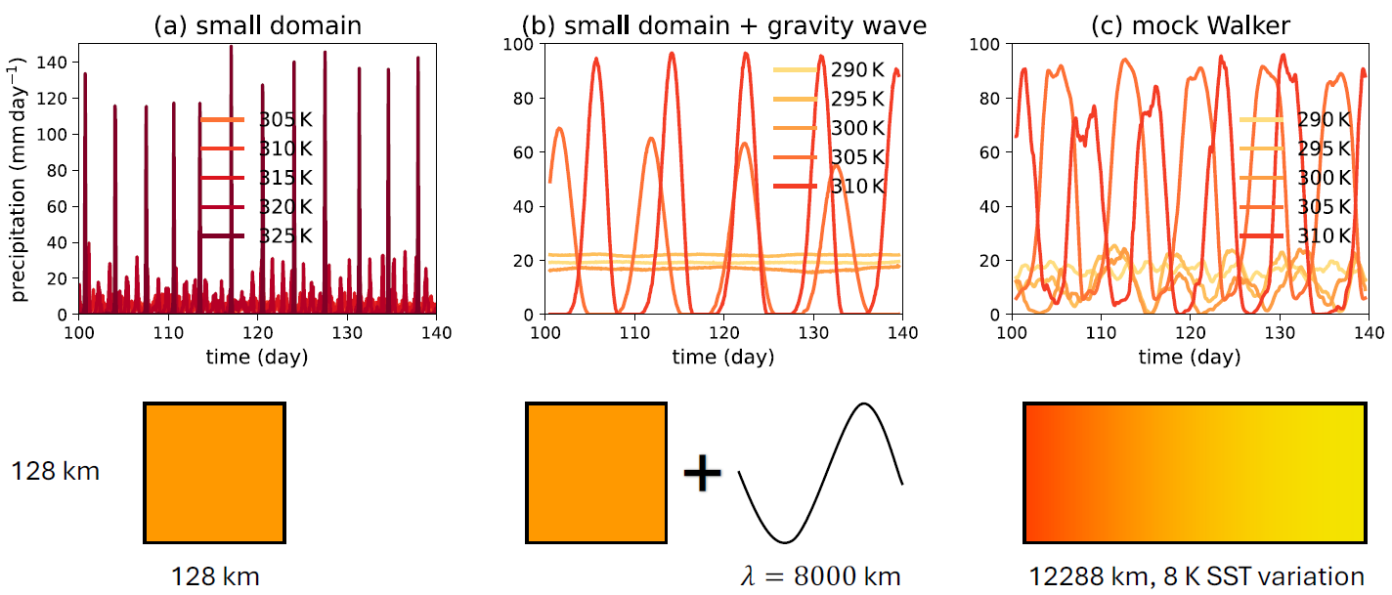

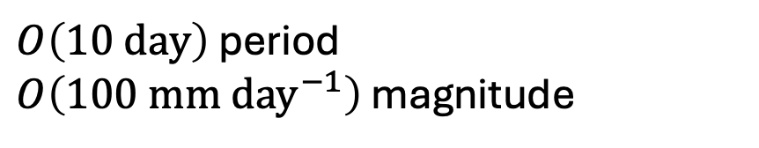
Periodic extreme rainfall in a warmer climate – CRM simulations
“Damped gravity wave” (Kuang, 2008, JAS)
Acknowledge: Nathanael Wong, Qiyu Song
+
128 km
SAM 6.11.5
128 km
$λ=8000$ km
$O\left(10 day\right)$ period
$O\left(100 mm {day}^{−1}\right)$ magnitude
Transition occurs at 305 K - 310 K

Slide 6
Periodic extreme rainfall in a warmer climate – CRM simulations
+
128 km
128 km
SAM 6.11.5
12288 km, 8 K SST variation
128 km
$λ=8000$ km
Transition occurs at 305 K - 310 K
Transition occurs at 305 K - 310 K

Slide 7
Large-scale waves lower the SST for the transition to 305 – 310 K
+
128 km
128 km
128 km
128 km
$λ=8000$ km
Transition occurs at 320 K - 325 K
Transition occurs at 305 K - 310 K
(Seeley & Wordsworth, 2021, Nature)
Notes:
90

Slide 8
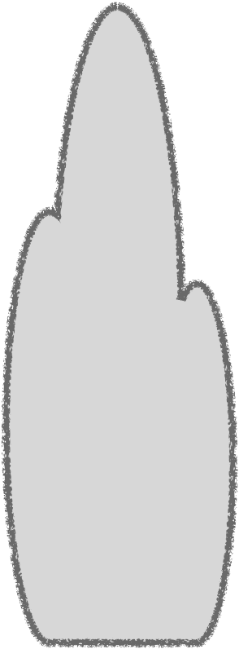
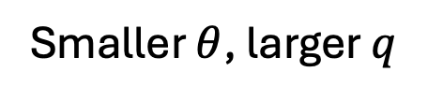


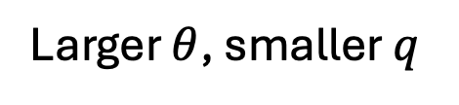
Mechanism: instability of convectively-coupled waves
z
z
Larger $θ$, smaller $q$
Cooling & moistening
Smaller $θ$, larger $q$
$$θ$$
$$q$$
Lower-troposphere ascending by a passing wave
Lower-troposphere advective cooling & moistening

Slide 9
Mechanism: instability of convectively-coupled waves
z
z
Larger $θ$, smaller $q$
+
Cooling & moistening
Smaller $θ$, larger $q$
$$θ$$
$$q$$
Lower-troposphere ascending by a passing wave
Lower-troposphere advective cooling & moistening
Larger RH, weaker entrainment
Stronger convection, self-reinforcement
Notes:
60

Slide 10
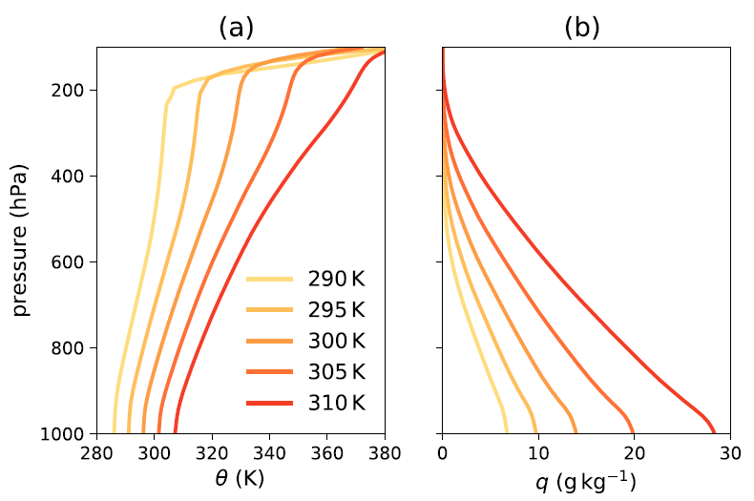
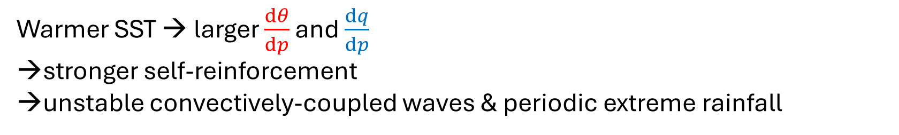
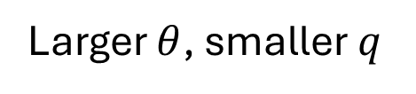
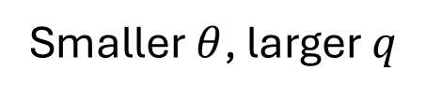
Mechanism: instability of convectively-coupled waves
Larger $θ$, smaller $q$
+
Cooling & moistening
Smaller $θ$, larger $q$
Warmer SST → larger $\frac{dθ}{dp}$ and $\frac{dq}{dp}$
stronger self-reinforcement
→unstable convectively-coupled waves & periodic extreme rainfall
Notes:
60

Slide 11
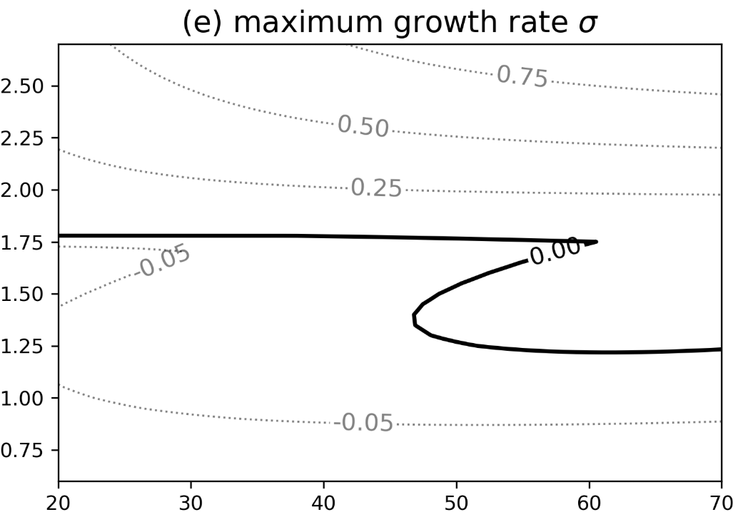
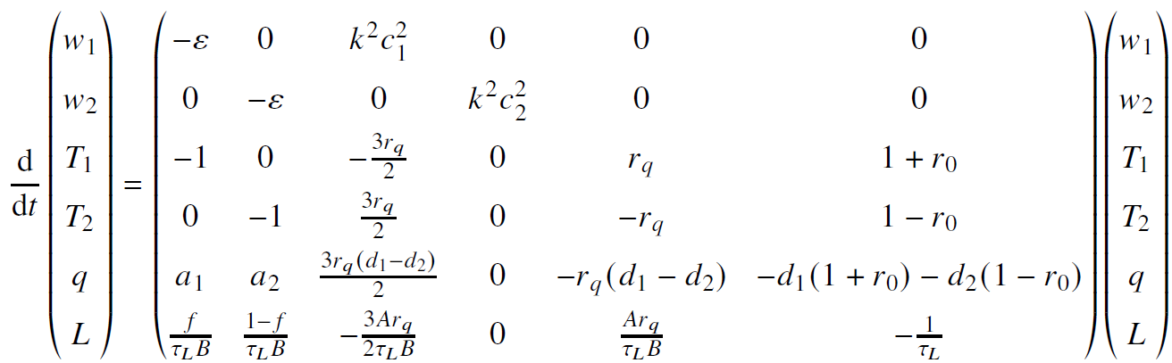
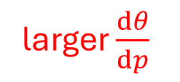

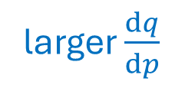

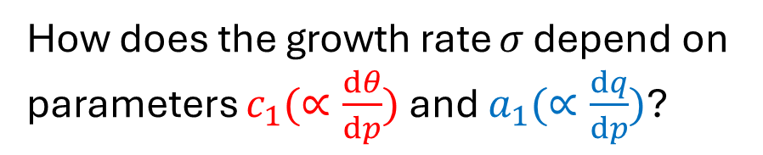
Mechanism: instability of convectively-coupled waves
a low-order model of 1st and 2nd baroclinic modes (Kuang, 2008, JAS)
larger $\frac{dq}{dp}$
$$a_{1}$$
warmer SST
How does the growth rate $σ$ depend on parameters $c_{1}(∝\frac{dθ}{dp})$ and $a_{1}(∝\frac{dq}{dp})$?
$$c_{1}$$
larger $\frac{dθ}{dp}$
Warmer SST → larger $\frac{dθ}{dp}$ and $\frac{dq}{dp}$
stronger self-reinforcement
→unstable convectively-coupled waves & periodic extreme rainfall

Slide 12
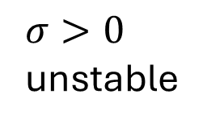
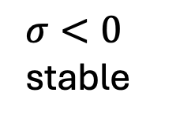
Mechanism: instability of convectively-coupled waves
a low-order model of 1st and 2nd baroclinic modes (Kuang, 2008, JAS)
larger $\frac{dq}{dp}$
$σ>0$
unstable
$$a_{1}$$
$σ<0$
stable
How does the growth rate $σ$ depend on parameters $c_{1}(∝\frac{dθ}{dp})$ and $a_{1}(∝\frac{dq}{dp})$?
$$c_{1}$$
larger $\frac{dθ}{dp}$
Warmer SST → larger $\frac{dθ}{dp}$ and $\frac{dq}{dp}$
stronger self-reinforcement
→unstable convectively-coupled waves & periodic extreme rainfall

Slide 13
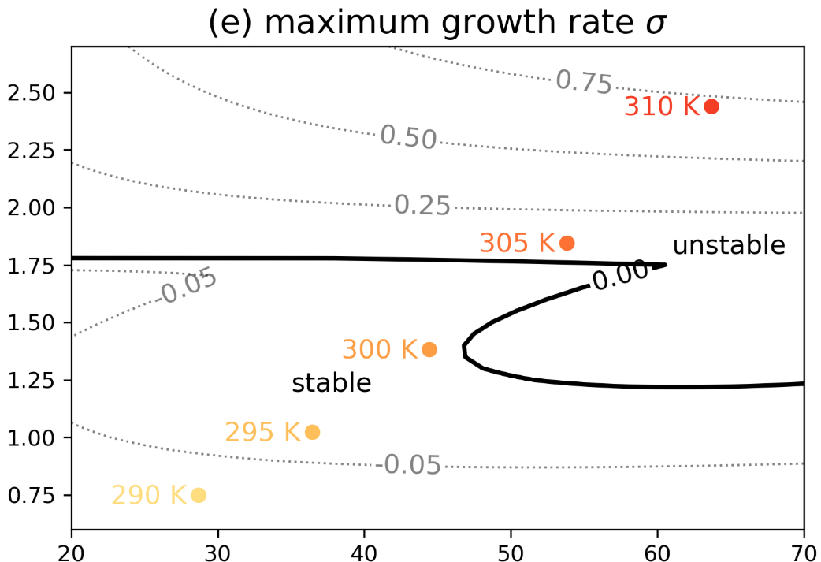
Mechanism: instability of convectively-coupled waves
larger $\frac{dq}{dp}$
$$a_{1}$$
$$c_{1}$$
larger $\frac{dθ}{dp}$
consistent SST threshold ~305 K
Warmer SST → larger $\frac{dθ}{dp}$ and $\frac{dq}{dp}$
stronger self-reinforcement
→unstable convectively-coupled waves & periodic extreme rainfall

Slide 14
The cycle of periodic extreme rainfall
z
adiabatic warming
time
Recharge phase: larger instability (CAPE) triggers convection

Slide 15
The cycle of periodic extreme rainfall
z
Cooling & moistening
adiabatic warming
time
Development phase: weaker entrainment → stronger & top-heavy convection

Slide 16
The cycle of periodic extreme rainfall
z
latent heating
Cooling & moistening
Latent cooling
adiabatic warming
time
Decay phase: larger stability (CIN) terminates convection
Notes:
90

Slide 17

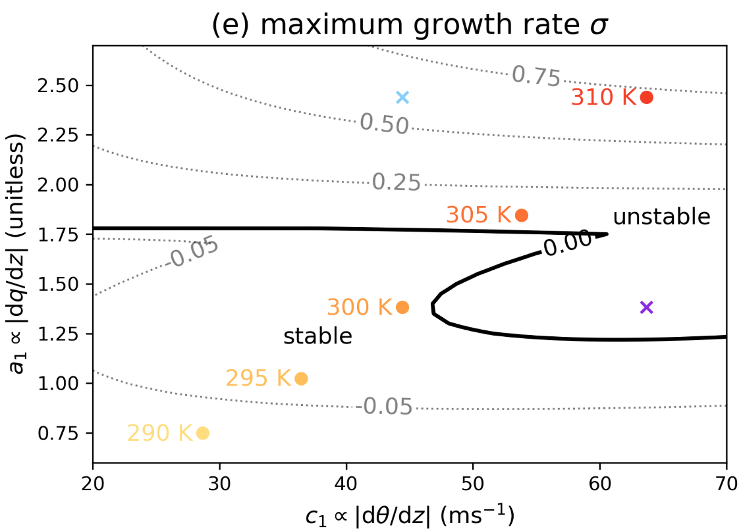
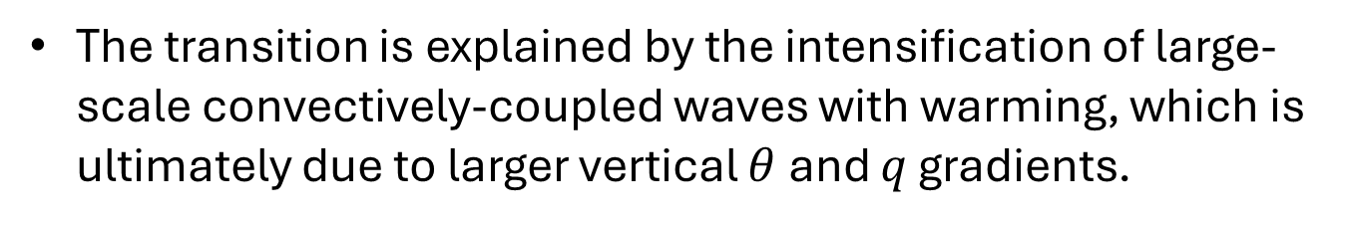
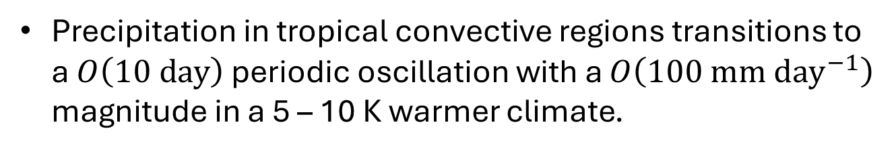
Conclusions
preprint
Precipitation in tropical convective regions transitions to a $O\left(10 day\right)$ periodic oscillation with a $O\left(100 mm {day}^{−1}\right)$ magnitude in a 5 – 10 K warmer climate.
The transition is explained by the intensification of large-scale convectively-coupled waves with warming, which is ultimately due to larger vertical $θ$ and $q$ gradients.
GCM simulations
CRM simulations
Low-order model

Slide 19
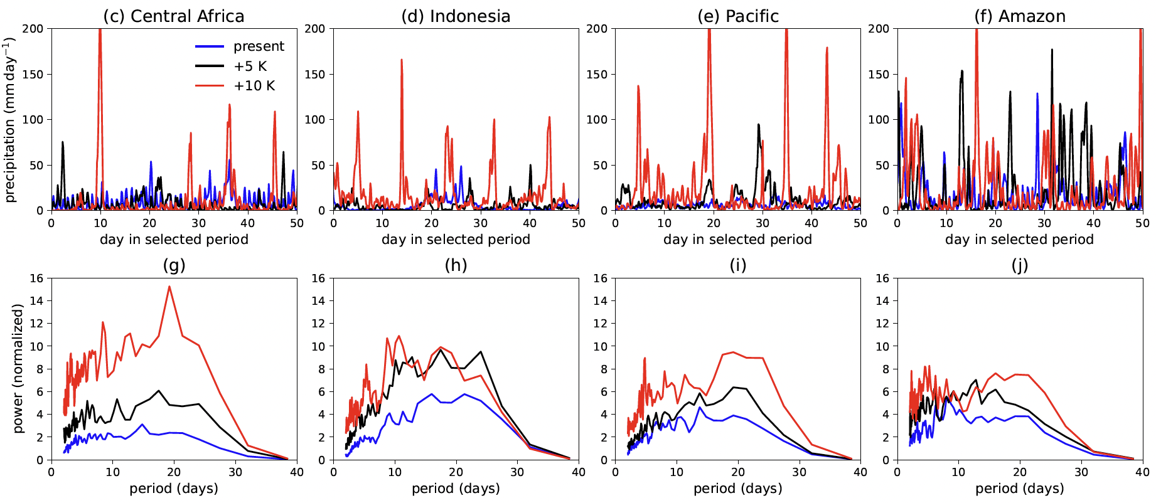
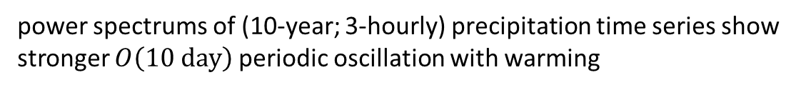
Periodic extreme rainfall in a warmer climate – GCM simulations
power spectrums of (10-year; 3-hourly) precipitation time series show stronger $O\left(10 day\right)$ periodic oscillation with warming

Slide 20
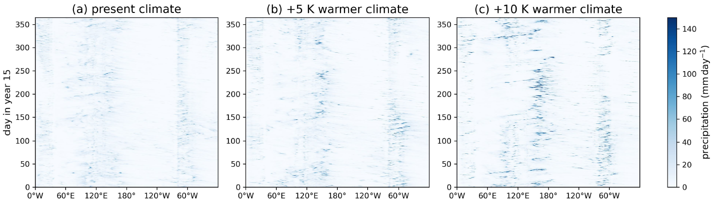
Transition associated with stronger convectively-coupled waves
Hovmoller diagrams of equatorial (10 S to 10 N) precipitation in year 15
Wave spectrums of equatorial precipitation indicate stronger convectively-coupled Kelvin waves

Slide 21
Large-scale waves are critical for the transition at 305 K - 310 K
Transition occurs at 320 K - 325 K
Convective-scale processes only (Seeley & Wordsworth, 2021, Nature)
Transition occurs at 305 K - 310 K
Convective-scale processes + parameterized large-scale waves
(following Kuang, 2008, JAS)
Transition occurs at 305 K - 310 K for precipitation in warm pool
Convective- & large-scale processes

Slide 22
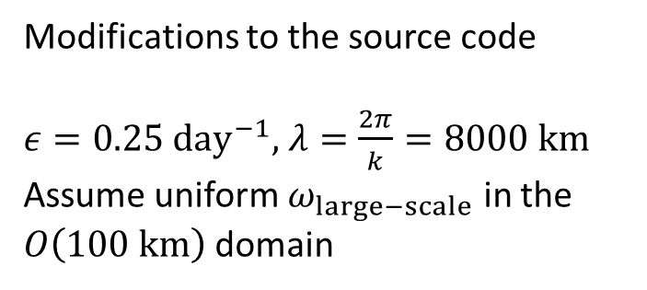
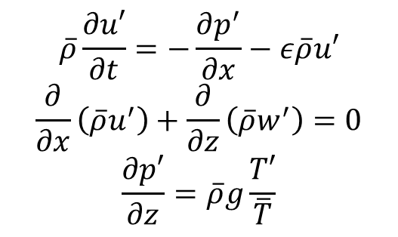
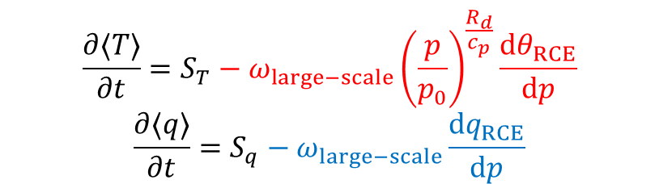
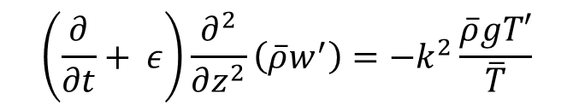
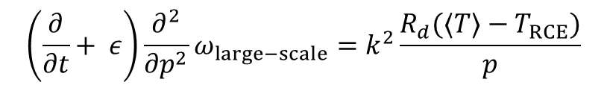


Method: coupling large-scale gravity waves to convection
2-D (x-z) damped gravity wave:
(Kuang, 2008, JAS)
$$\overline{ρ}\frac{∂u′}{∂t}=−\frac{∂p^{′}}{∂x}−ε\overline{ρ}u′$$
$$\frac{∂}{∂x}\left(\overline{ρ}u^{′}\right)+\frac{∂}{∂z}\left(\overline{ρ}w^{′}\right)=0$$
$$\frac{∂p′}{∂z}=\overline{ρ}g\frac{T′}{\overline{T}}$$
$F′\left(x,z,t\right)=Re[\hat{F}\left(z,t\right)e^{−ikx}]$
$$\left(\frac{∂}{∂t}+ ε\right)\frac{∂^{2}}{∂z^{2}}\left(\overline{ρ}w^{′}\right)=−k^{2}\frac{\overline{ρ}gT′}{\overline{T}}$$
Remove $u′$ and $p^{′}$
$$\left(\frac{∂}{∂t}+ ε\right)\frac{∂^{2}}{∂p^{2}}ω_{large−scale}=k^{2}\frac{R_{d}(⟨T⟩−T_{RCE})}{p}$$
Modifications to the source code
$ε=0.25 day^{−1}$, $λ=\frac{2π}{k}=8000 km$
Assume uniform $ω_{large−scale}$ in the $O\left(100 km\right)$ domain
$$\frac{∂⟨T⟩}{∂t}=S_{T}−ω_{large−scale}{\left(\frac{p}{p_{0}}\right)}^{\frac{R_{d}}{c_{p}}}\frac{dθ_{RCE}}{dp}$$
$$\frac{∂⟨q⟩}{∂t}=S_{q}−ω_{large−scale}\frac{dq_{RCE}}{dp}$$

Slide 23
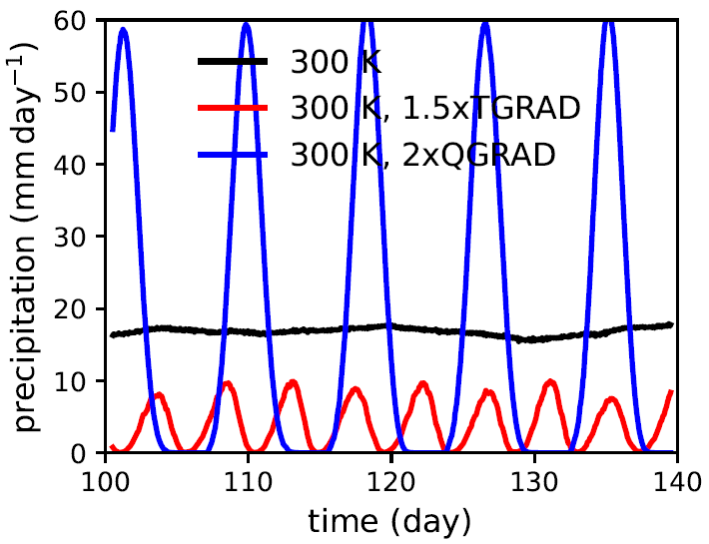
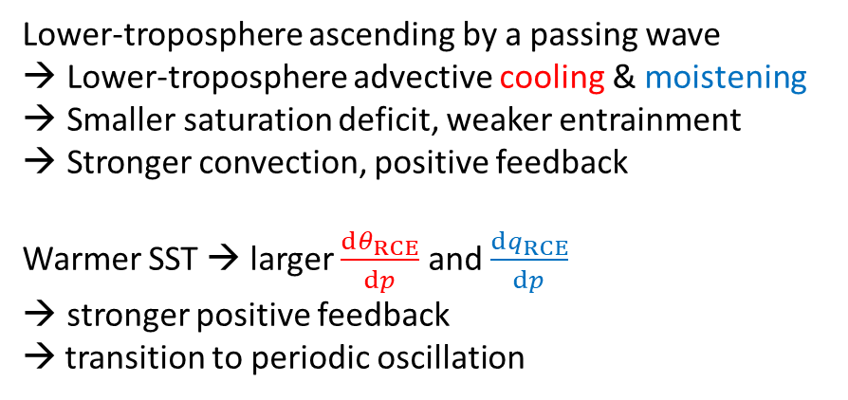
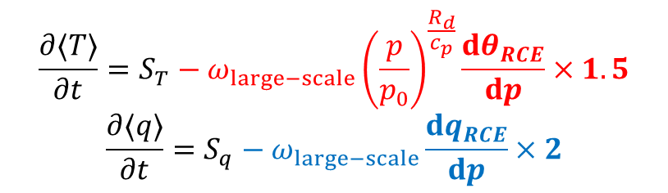
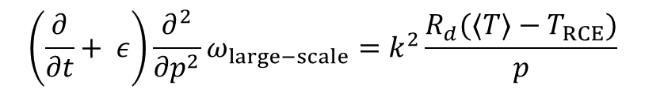
Mechanism: instability of convectively-coupled waves
$$\left(\frac{∂}{∂t}+ ε\right)\frac{∂^{2}}{∂p^{2}}ω_{large−scale}=k^{2}\frac{R_{d}(⟨T⟩−T_{RCE})}{p}$$
$$\frac{∂⟨T⟩}{∂t}=S_{T}−ω_{large−scale}{\left(\frac{p}{p_{0}}\right)}^{\frac{R_{d}}{c_{p}}}\frac{dθ_{RCE}}{dp}×1.5$$
$$\frac{∂⟨q⟩}{∂t}=S_{q}−ω_{large−scale}\frac{dq_{RCE}}{dp}×2$$
Lower-troposphere ascending by a passing wave
Lower-troposphere advective cooling & moistening
Smaller saturation deficit, weaker entrainment
Stronger convection, positive feedback
Warmer SST → larger $\frac{dθ_{RCE}}{dp}$ and $\frac{dq_{RCE}}{dp}$
stronger positive feedback
→ transition to periodic oscillation

Slide 24
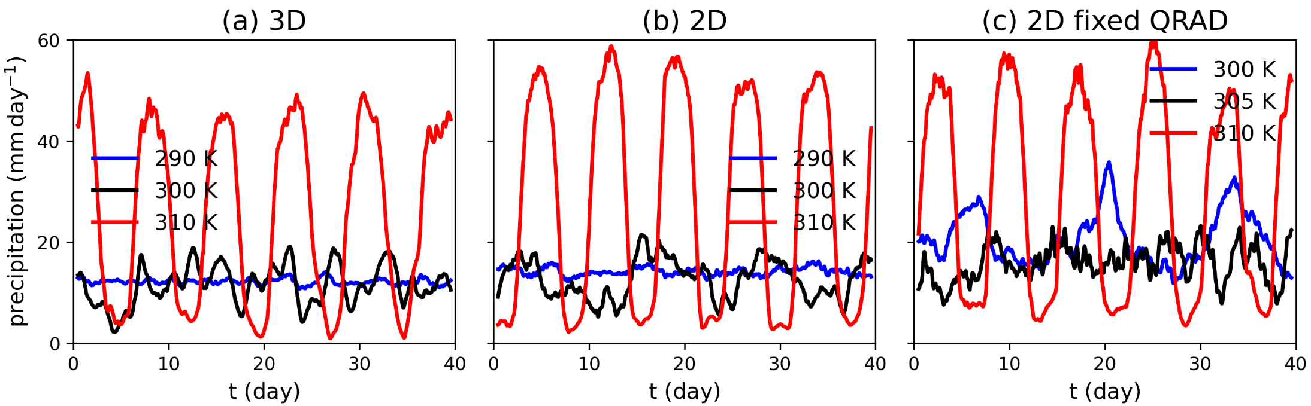
Periodic extreme rainfall in a warmer climate – CRM simulations
The transition to periodic rainfall occurs under different settings of mock Walker simulations

Slide 25
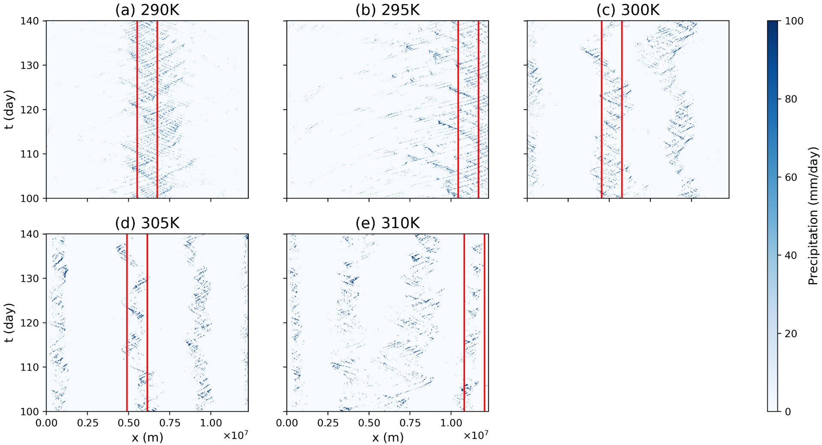
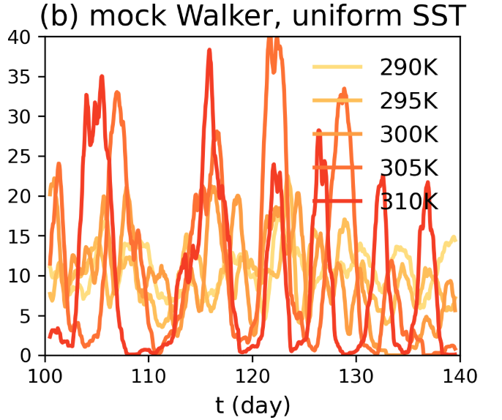
Periodic extreme rainfall in a warmer climate – CRM simulations
The transition to periodic rainfall and the intensification of convectively-coupled gravity waves also occurs in simulations with uniform SST

Slide 26
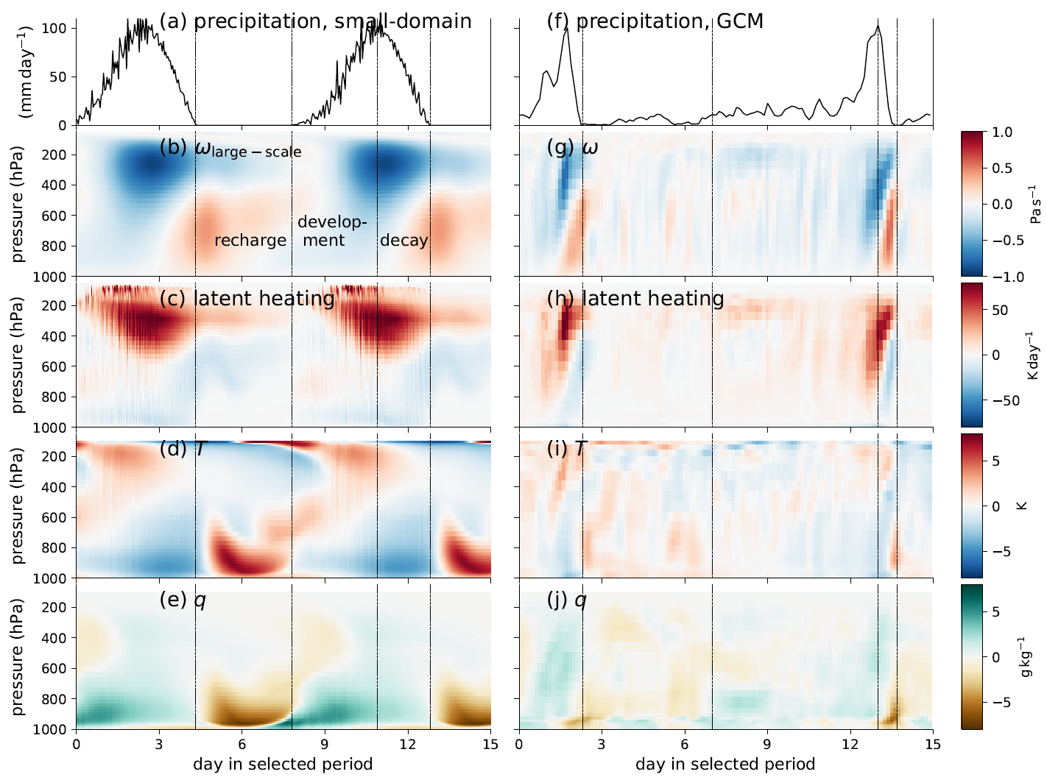
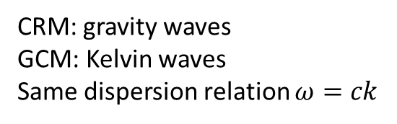
Mechanism: instability of convectively-coupled waves
Similar convection cycles in small-domain CRM simulations and GCM simulations
CRM: gravity waves
GCM: Kelvin waves
Same dispersion relation $ω=ck$

